Slide 1
Digital Portfolio
STUDENT NAME: KARTHIK. R
REGISTER NO AND NMID: 24131061802521031/5B2069D03EFB920903F4B3F2D3BCF1ED
DEPARTMENT: B. SC COMPUTER SCIENCE 2ND YEAR
COLLEGE: COLLEGE/ UNIVERSITY SHREE RAGHAVENDRA ARTS AND COLLEGE KEELAMOONGILADI ANNAMALI UNIVERSITY

Slide 2
PROJECT TITLE
Portfolio weppage

Slide 3


AGENDA
Problem Statement
Project Overview
End Users
Tools and Technologies
Portfolio design and Layout
Features and Functionality
Results and Screenshots
Conclusion
Github Link
3/21/2024 Annual Review

Slide 4

PROBLEM STATEMENT
A personal portfolio website that is responsive, clean, and user-friendly. It highlights personal information, projects, and achievements while allowing easy contact through a form or social links.

Slide 5

PROJECT OVERVIEW
A project overview is a concise, high-level document that provides a quick snapshot of a project. It serves as a blueprint, offering a clear, digestible summary of the project's purpose, goals, and direction for all stakeholders and team members. Think of it as an executive summary for your project.

Slide 6

WHO ARE THE END USERS?
A portfolio is a curated collection of a person's work, designed to showcase their skills, experience, and accomplishments. It's a professional snapshot used to demonstrate competence and potential to employers, clients, or academic institutions.

Slide 7
TOOLS AND TECHNIQUES
* HTML 5
* CSS 3
* JAVASCRIPT
* VS Code
* browser developer

Slide 8
POTFOLIO DESIGN AND LAYOUT
Portfolio Website Layout (Wireframe)
Header/Navbar
Hero Section
About Me
Projects
Contact
Footer
‹#›

Slide 9
FEATURES AND FUNCTIONALITY
Downloadable resume option
Project showcase with images and links
Social media integration (LinkedIn, GitHub, etc.)
Interactive project cards with hover effects
Contact form to send messages directly
Resume download button (PDF format)
External links for project demos & GitHub repositories

Slide 10
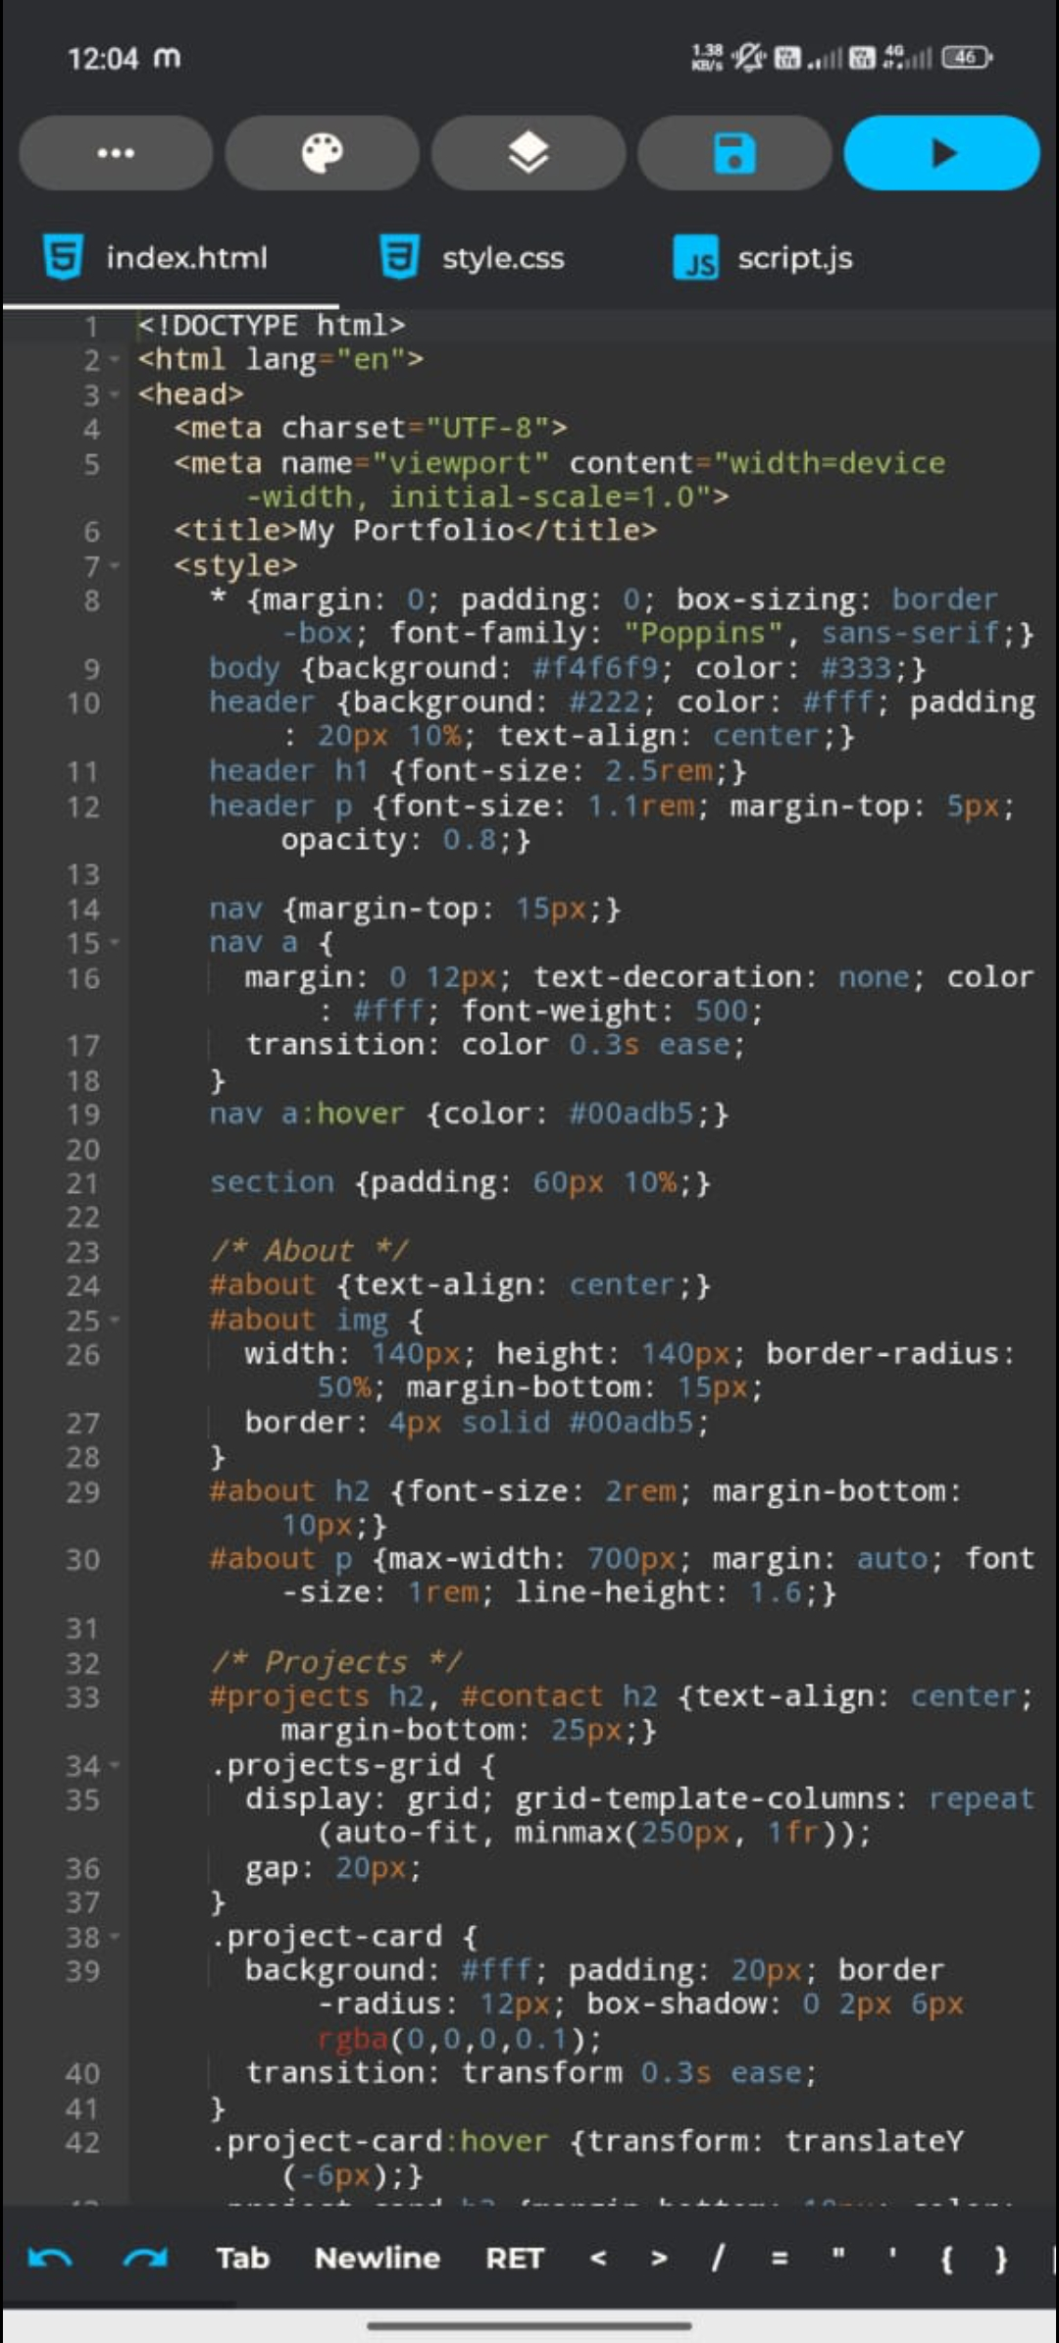
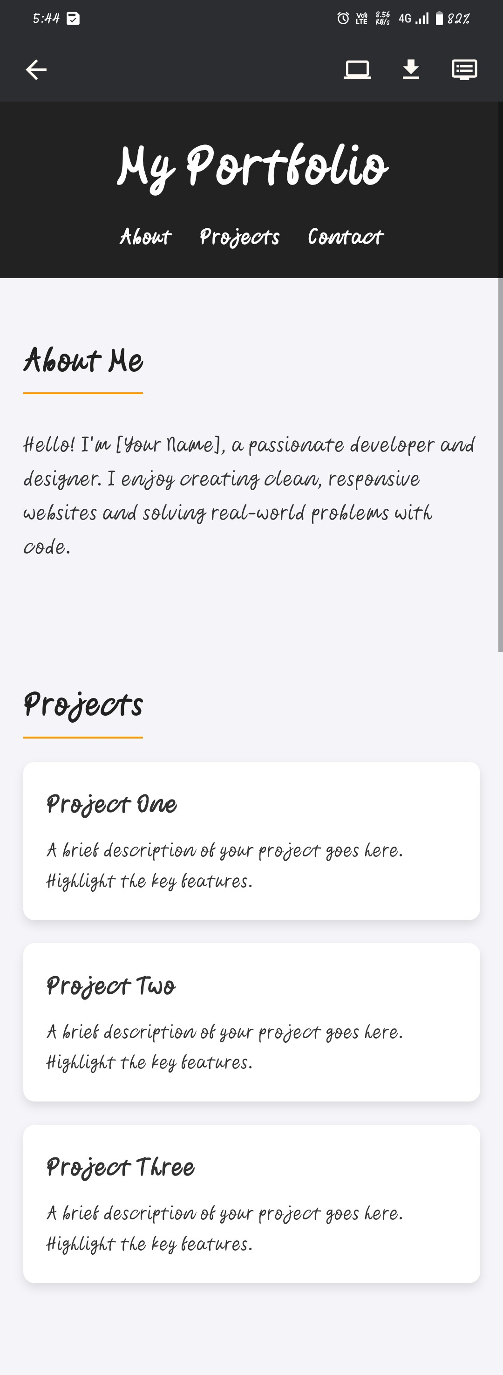
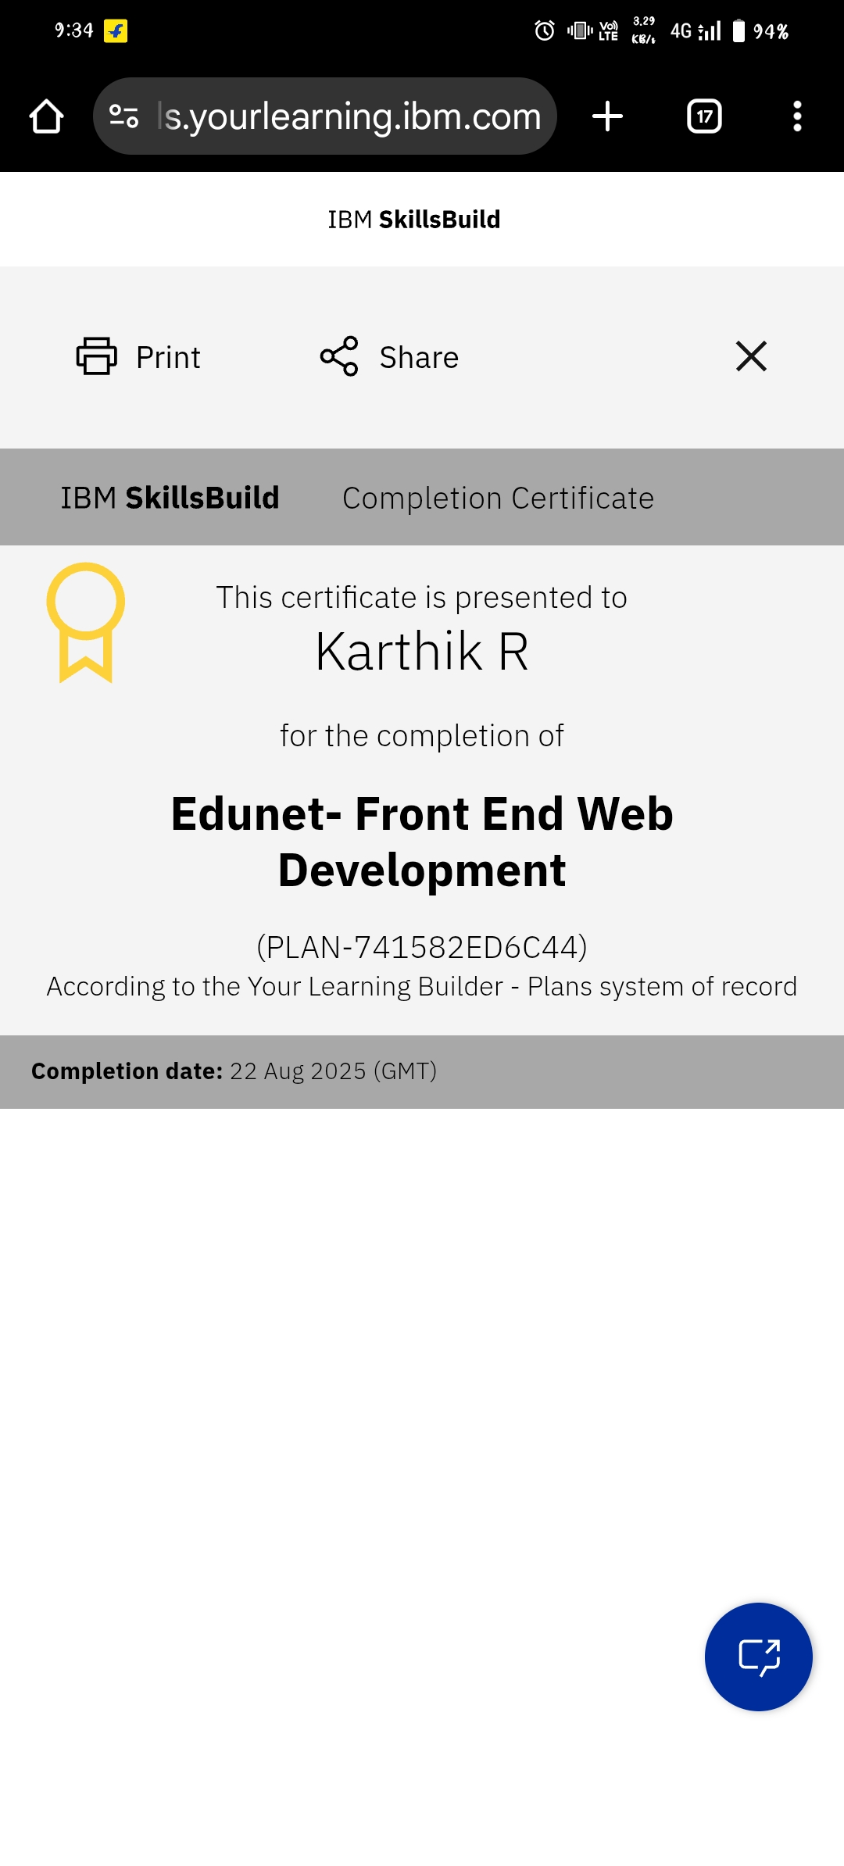
RESULTS AND SCREENSHOTS
3/21/2024 Annual Review
‹#›

Slide 11
CONCLUSION
A responsive portfolio website was successfully developed.
It effectively showcases profile, projects, and contact details.
The design is surple, modem, and user-filendly,
‹#›

